Slide 1
DATAWAREHOUSE ASSIGNMENT
TOPIC – Travel and hospitality
NAME | BITS ID | EMPLOYEE ID
Chetan | 2017HW86656 | 954245
Chanchal | 2017HW86716
Ashutosh | 2017HW86512
Pratibha | 2017HW86771
Urvashi | 2017HW86739

Slide 2
INTRODUCTION :
Hotel business process involves Big Data Warehouse (BDW), in order to be used by the analytical components in a context of Business Intelligence (BI) and support the different kinds of management in a hotel business. In addition, in a BDW some tasks must be performed: (i) integration of the information collected from different internet sources. (ii) Update and maintenance of the new information gathered from the internet (once the information about accommodation is constantly changing), e.g., the rooms prices or the promotions offered in according with the customer profile. (iii) Maintenance of the historical data, which will be relevant to the hotel big data analytics, in order to achieve the business intelligence systems requirements.Dimensional modeling is a data warehouse design technique that uses a data structure similar to the easily understood entity-relationship (ER) model but is sophisticated in that it supports high-performance data access. Dimensional modeling refers to the process of designing the structure of a data warehouse through illustrations that show relationships between data tables. An example of dimensional modeling, also known as “star schema”.Hotel is well behind in the area of data warehouse management and decision support and needs to move forward in this direction.

Slide 3
Business processes of interest to senior management
This framework will encourage hotel and lodging enterprises to see their activities from a cross-industry process viewpoint instead of a narrow functional viewpoint.
The transformation of a hotel organization towards a business process management system with horizontal or process management point out the need to leave functional organizational in a hotel, and directs attention of its managers to different types of business processes: operating processes, management processes and support processes.
The proposed framework for operating processes are very useful for hotel managers , since they point out the relevance of more consistent application of business process management system in day-to-day business activities with the aim of effective decision-making
Business processes are one of the important elements of hotel management system. If they are not developed, documented and implemented, we can fairly ask whether the hotel management system is capable of meeting requests of interested parties, primarily hotel guests.

Slide 4
Questions that would be raised for process/profitability/operations improvement
Four key operating processes in the hotel are: 1) the process of hotel housekeeping, 2) the process of supplying necessary inputs, 3) the process of guests arrivals and departures and 4) the process of producing and serving food and beverage.
Supporting processes are: understand markets and services, develop vision and strategy, design hotel products and services and market and sell. Understand markets and services comprised of three activities: determine customer needs and wants, measure customer satisfaction and monitor changes in market or customer expectations.
Main activities within a process of develop vision and strategy are: monitor the external environment, define business concept and organizational strategy, design the organizational structure and relationships between organizational units and develop and set organizational goals.
Design products and services activities are: develop new product/service concept and plans, design, build and evaluate prototype products and services, refine existing products/services, test effectiveness of new or revised products or services, prepare for production and manage the product/ service development process. And, the last support process is market and sell, which comprised of next activities: market product or services to relevant customer segments and process customer orders.

Slide 5
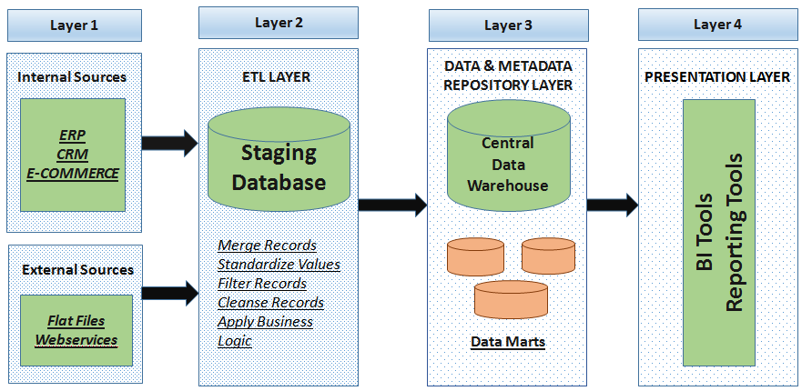
DW Architecture

Slide 6
EXPLANATION
In dataware house architecture, data is collected from different so and then various opeartions are applied on it.
The data sourcing, transformation, and migration tools are used for performing all the conversions, summarizations, and all the changes needed to transform data into a unified format in the dataware house. They are also called Extract, Transform and Load (ETL) Tools.
The name Meta Data suggests some high- level technological concept. However, it is quite simple. Metadata is data about data which defines the data warehouse. It is used for building, maintaining and managing the data warehouse.
In the Data Warehouse Architecture, meta-data plays an important role as it specifies the source, usage, values, and features of data warehouse data. It also defines how data can be changed and processed. It is closely connected to the data warehouse.
One of the primary objects of data warehousing is to provide information to businesses to make strategic decisions. Query tools allow users to interact with the data warehouse system.

Slide 7
DW schema(below diagram is 3rd normal form
Payment_Mode
Address
Guests
Hotel_Reservations
Staff
Hotel
Reserved_Room
Calendar
Rooms

Slide 8
Details Of All The Tables:-
Hotel
PK Hotel_ID int
FK Cedit_Card_ID int
FK Guest_ID int
FK Date_From date
FK Date_To date
FK Reservation_ID int
FK Staff_ID int
FK Room_ID int
Hotel_Reservation
PK Reservation_ID int
Date_From date
Date_To date
Made_By varchar(40)
FK Guest_ID int
Reserved_Room
PK ID int
Status Varchar
No.of rooms int
FK Room_id int
FK Reservation_ID int
Staff
PK Staff_ID int
FK Room_ID int
Staff_Name varchar(30)
ADDRESS
City Varchar(10)
State Varchar(15)
Zipcode int
Country Varchar(30)
ROOMs
PK Room_ID int
PK Room_Type varchar(20)
Smoke boolean

Slide 9
GUESTS
PK Guest_id int
First_Name varchar(20)
Last_Name varchar(15)
FK Resrvation_ID int
Payment_Mode
PK Payment_ID int
FK Guest_ID int
Other_Details varchar(50)
Calendar
PK Day date

Slide 10
Possible ETL jobs and test cases
Test cases for Hotel:
Add Reservation
1.Verify that user can add reservation .
2.Verify that system should calculate & display the departure date.
3.Verify that user can select an empty room.
4.Verify that system generates a unique id every reservation.
5Verify that system must display a confirmation message upon saving reservation.
6.Verify that System updates the existing reservation list.
7.Verify that every field in the reservation form only accept the respective input only.
Check – In
1.Verify that user can invoke check - in interface by clicking 'CK-IN' button from the main menu.
2.Verify that System display reservation information.
3.Verify that System allow user can change reservation status from 'reserve' to 'check-in' by clicking check-in button.
4.Verify that System should allow user to print check - in details.

Slide 11
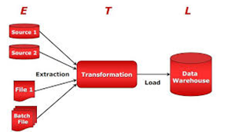
Check Out
1.Verify that System should allow user to invoke check out interface by
clicking 'C OUT' button.
2. Verify that System should allow user to invoke search reservation guest to
search reservation.
3. Verify that System should allow user to change reservation status to 'check-out‘
in main reservation list.

Slide 12
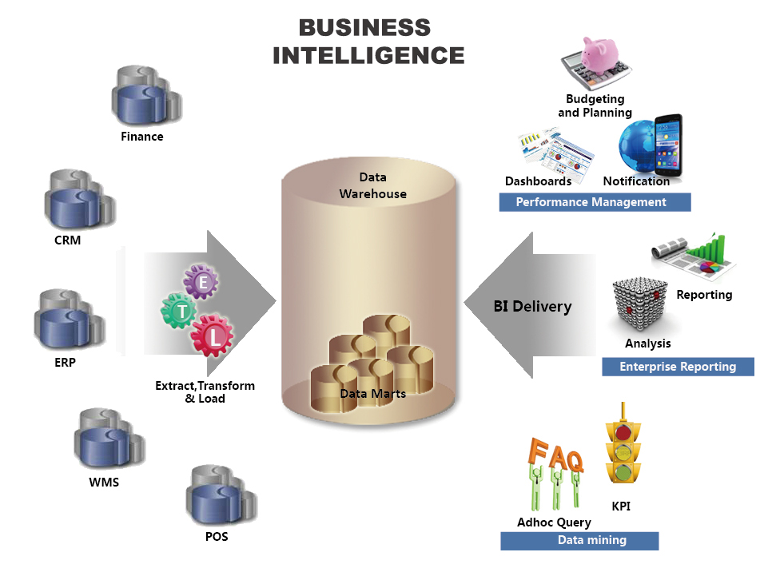
List possible BI reports and test cases

Slide 13
Contd…….
BI Test cases for Hotel
1. To satisfy the hotels and consumer needs, it is essential to have access to a Business Intelligence (BI) system, which consolidates all the relevant data to be used by the analytical tools.
2. In this sense, BI systems have some challenges related to the definition of an adequate methodology to integrate and store the retrieved data into a hospitality Big Data Warehouse.
3. (i) integration of the information collected from different internet sources.
(ii) Update and maintenance of the new information gathered from the internet (once the information about accommodation is constantly changing), e.g., the rooms prices or the promotions offered in according with the customer profile.
(iii) Maintenance of the historical data, which will be relevant to the hotel big data analytics, in order to achieve the business intelligence systems requirements

Slide 14
Aggregations that would improve DW performance
Aggregates are used in dimensional models of the data warehouse to produce dramatic positive effects on the time it takes to query large sets of data. At the simplest form an aggregate is a simple summary table that can be derived by performing a Group by SQL query.
The single most dramatic way to affect performance in a large data warehouse is to provide a proper set of aggregate (summary) records that coexist with the primary base records. Aggregates can have a very significant effect on performance, in some cases speeding queries by a factor of one hundred or even one thousand. No other means exist to harvest such spectacular gains.

Slide 15
Contd……..
Aggregations that would improve DW performance
1. Having aggregates and atomic data increases the complexity of the dimensional model.
2. This complexity should be transparent to the users of the data warehouse,thus when a request is made, the data warehouse should return data from the table with the correct grain. So when requests to the data warehouse are made, aggregate navigator functionality should be implemented, to help determine the correct table with the correct grain.
3. The number of possible aggregations is determined by every possible combination of dimension granularities. Since it would produce a lot of overhead to build all possible aggregations, it is a good idea to choose a subset of tables on which to make aggregations.
4. The best way to choose this subset and decide which aggregations to build is to monitor queries and design aggregations to match query patterns.

Slide 16
Metadata items that will be of interest to various stakeholders
In a data warehouse, we create metadata for the data names and definitions of a given data warehouse. Along with this metadata, additional metadata is also created for time-stamping any extracted data, the source of extracted data.Metadata in a data warehouse defines the warehouse objects.
For example:
The menucard of a hotel serves as a metadata for the contents in the menucard of a hotel.

Slide 17
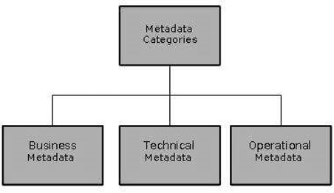
Contd……

Slide 18
Contd……….
1.Data acquisition MetaData
Used for administering & monitoring the ongoing functions of the DW Monitoring ongoing Extraction & Transformation Ongoing load images are created properly using the Data Acquisition metadata used by users to find the data sources for the data elements in his/her queries.
2.Data Storage Metadata
The tools record the metadata elements during the development phases as well as while the dataWare house is in operation after deployment
Metadata used for development, administration, and by the users
  Used for full data refreshes and incremental data loads
  DBA will use for processes of recovery, backup, and tuning
  For purging and archiving of data
  User wanting to do a drill-down from total quarterly sales to sales districts, would want to know
  about when was the last time the data on district delineation was loaded

Slide 19
Contd…….
3.Information Delivery Metadata
Most of the processes in this area are meant for end users while using the processes, end-users generally use metadata recorded in processes of the other two areas of data acquisition and data storage when a user creates a query with the aid of a query processing tool, he or she can refer back to metadata recorded in the data acquisition and data storage areas can look up the source data configurations, data structures, and data transformations from the data acquisition area metadata can look up date of last full refresh and the incremental loads forvarious tables from the data storage area metadata
4. Business Metadata
Less structured than technical metadata, Originates from textual documents, spreadsheets, and even from business rules and policies that are not written down completely. Most business users do not have technical skills to create their own queries or format their own reports.
5. Technical Metadata
Defines the objects and processes that make up the DW system from a technical perspective
System metadata:
  Defines data structures
  Table, fields, indexes, and partitions in the relational engine
  Databases, dimensions, and measures

Slide 20
THANK YOU
*************

